Slide 1
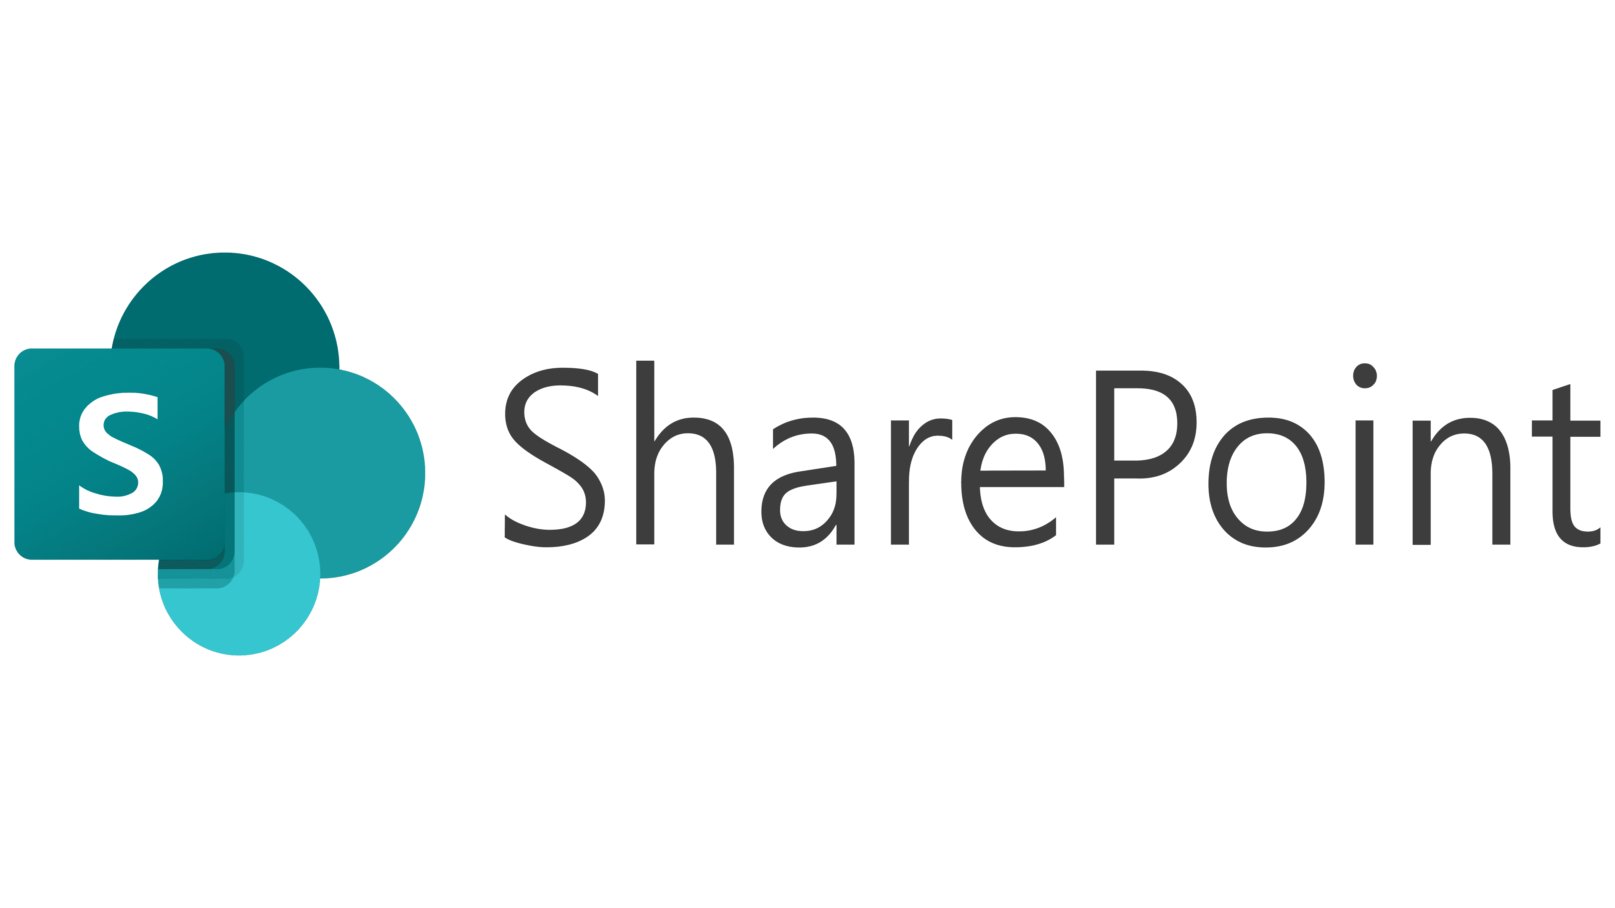

Accessing TSS on Production SharePoint for Procurement
Mohamad Saif Imran
Production Tooling Coordinator
Jira Administrator for Airfoil Services Sdn Bhd
Production SharePoint Owner

Slide 2
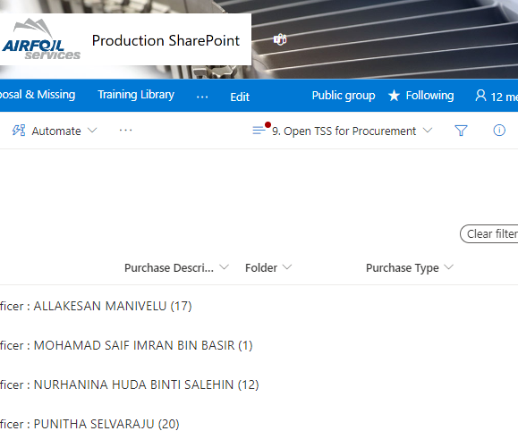
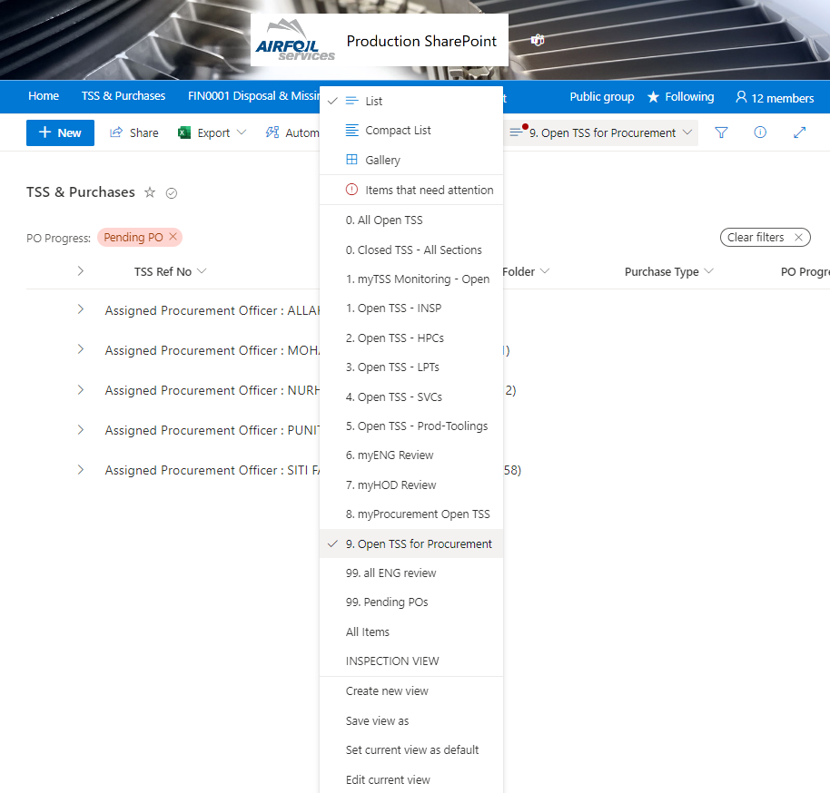

Accessing TSS on Production SharePoint
Tutorial 1: How to open Production SharePoint site.
1
Open Production SharePoint from this link:
https://airfoilservicessb.sharepoint.com/sites/ProductionSharePoint/Lists/TSS%20%20Purchases/8%20myTSS%20Procurement.aspx
For Procurement scope, there are two types of views.
myProcurement Open TSS – this view shows all TSS Pending POs that are only assigned to you
Open TSS for Procurement – this view shows all TSS Pending POs and grouped into all Procurement Officers
2
You may access these views by clicking the links in Step 2, or by changing the view from Production SharePoint site as shown below.
2

